Slide 1
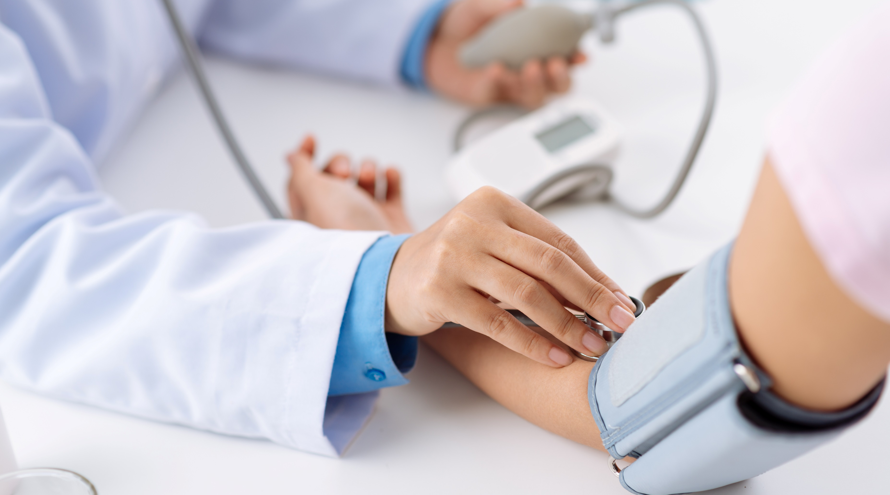
CSE3085 - Predictive Analytics with Case Studies
j component
Domain :-
Predictive analytics in healthcare

Slide 2

20MIA1031 - SANJAY.M
topic - Diabetics prediction
01
20MIA1162 – GUNA SHANKAR S
topic - Human Stress Detection
02
Team Members
Topics
20MIA1117 - PILLARAM MANOJ
topic - Brain Stroke Prediction
03
20MIA1039 - SRIGANTH.R
topic - Heart Disease Prediction
04
20MIA1106 - MADHUKIRAN P
topic - Insurance claim prediction
05

Slide 3
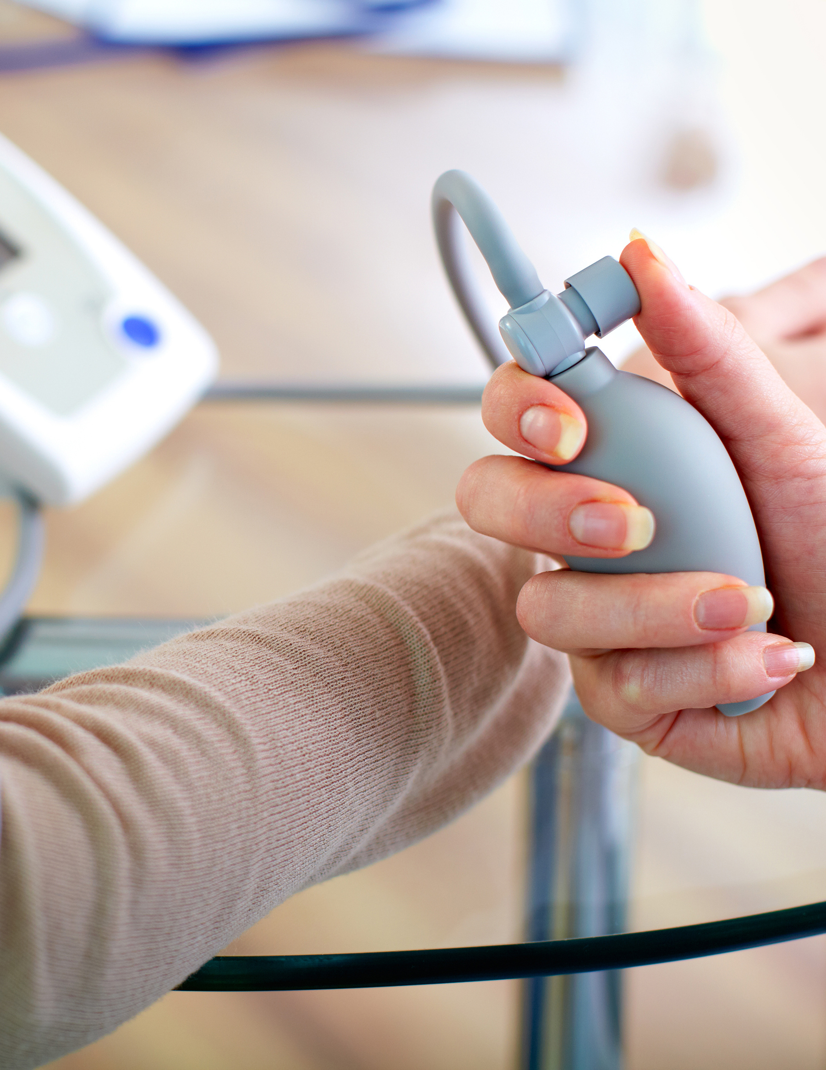
20MIA1031
SANJAY.M
Diabetics prediction
.

Slide 4
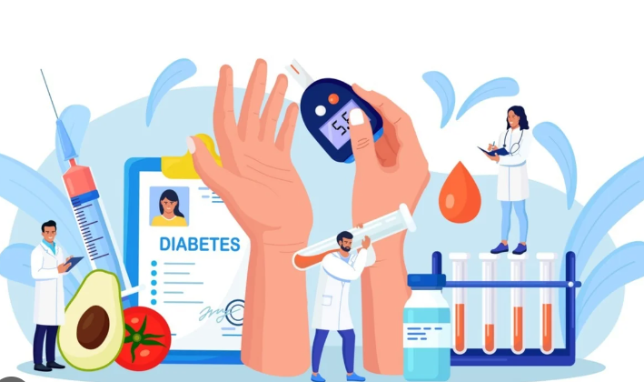
OBJECTIVE
I chosen this healthcare domain because, Diabetes is becoming a more serious health problem as a result of our inactive lifestyle. If it is detected in time, adverse effects can be avoided with proper medical treatment. Technology can be used very reliably and efficiently to aid in early detection.I thought of developing a predictive model using machine learning that can predict whether a patient has diabetes or not.

Slide 5



Introduction
Diabetics prediction
According to the International Diabetes Federation, 382 million people worldwide have diabetes.
By 2035, this figure will have more than quadrupled to 592 million.
According to the World Health Organization, around 422 million people suffer with diabetes, the majority of whom live in poor or middle-income nations. This figure might be boosted to 490 billion by 2030. Diabetes is prevalent in several countries, including Canada, China, and India. With India's population currently over 100 million, the real number of diabetics in the country is 40 million
Diabetes that is uncontrolled can raise the risk of a heart attack, cancer, kidney damage, blindness, and other disorders.
Diabetes is a chronic disease that has the potential to trigger a global health disaster.
Diabetes is a condition caused by a rise in blood glucose levels. This high blood glucose level causes symptoms such as frequent urination, thirst, and hunger.
The goal of the analysis on diabetes prediction models in refereed articles was to discover the ways for selecting the best quality research and synthesising the many studies

Slide 6
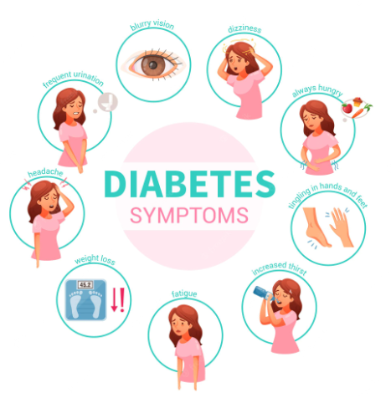
Diabetes is classified into three categories.
The first is juvenile diabetes which primarily affects youngsters and damages the cells in the pancreas that create insulin. The second form of diabetes occurs beyond the age of 40 as a result of a lack of activity and an unhealthy lifestyle. Diabetes is a chronic condition that cannot be cured but may be managed with medicines, regular walks and exercise, and a healthy diet.
Type 2 diabetes is also known as insulin-independent diabetes because patients are not treated with insulin at regular intervals, whereas type 1 diabetes is known as insulin-dependent diabetes because insulin is administered to the patient at regular intervals.
The third form of diabetes is gestational diabetes, which originates during pregnancy owing to hormonal changes and normally fades after delivery. There is one additional disease, prediabetes, in which sugar intake levels are borderline, and this condition can be rectified with regular exercise and a good lifestyle.
Diabetes diagnosis is regarded as a difficult subject for quantitative research. Due to constraints, various criteria like as fructosamine, white blood cell count, fibrinogen, and haematological indices have been demonstrated to be ineffective.

Slide 7

Background study
Based on a survey of studies in the literature they Classification on several sorts of datasets may be used to determine
whether or not a person is diabetic. The diabetic patient's data set is created by obtaining information from
the hospital warehouse, which has some instances with some characteristics.
Sun and Zhang discussed several deep learning and classification methods,
including artificial neural networks, decision trees, random forests
and support vector machines.
.
For the classification of diabetes data, Qawqzeh and his colleagues used
a logistic regression classification technique. There are 459 patients
in the training data set, and 128 patients in the testing data set.
The authors achieved 92% classification accuracy using logistic regression.
The model's main disadvantage was that it was not compared to other diabetic
prediction models and thus could not be validated.
■
Dwivedi used an adaptive neurofuzzy inference system and a feature selection method called principal component
analysis to improve the accuracy of a diabetic prediction model.

Slide 8
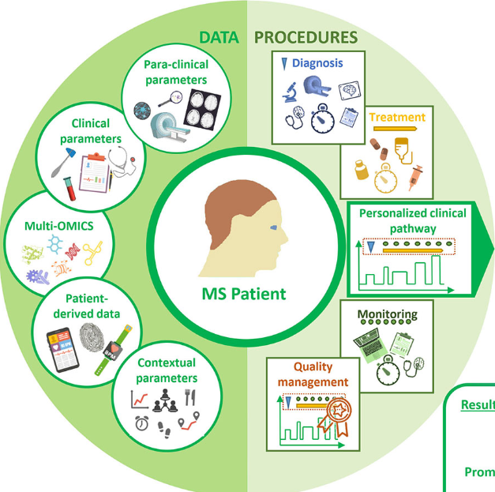
Background study
On the Pima Indians Diabetes Dataset, Sisodia used Nave Bayes, decision trees,
and support vector machine learning algorithms, with the Nave Bayes classifier
achieving the highest accuracy in predicting diabetes.
Maniruzzaman and his colleagues worked with data from the National Health
and Nutrition Examination Survey. Using logistic regression methods,
features were chosen, and the random forest classifier produced the best results.
■
Ramesh proposed a framework for automating the process of diabetes prediction
using health devices such as smartwatches or smartphones. The support vector
machine is the machine learning classifier used by the authors to classify the dataset.
Kamrul Hasan and his other collegues used Nave Bayes, gradient boost, decision
trees,random forest, multilayer perceptron, and AdaBoost to compare independent
component analysis, correlation attribute feature selection, and principal component
analysis feature selection methods. An ensemble of AdaBoost and gradient boostclassifiers
produced an accuracy of 78.9%.

Slide 9
Prediction performed (Algorithms used)
Using Machine Learning Once the data is available,they used the Machine Learning Technique. To forecast diabetes, several classification and ensemble algorithms. The strategies were tested on a diabetic dataset from sourses.
The main goal is to use Machine Learning Techniques to examine the performance of various approaches and determine their accuracy, as well as to identify the responsible/important features that play a significant part in prediction
Algorithms
Support Vector Machine
Decision Tree
.
Logistic Regression
K-Nearest Neighbor
Random Forest
.
.
ANN
Nave Bayes
MLP

Slide 10


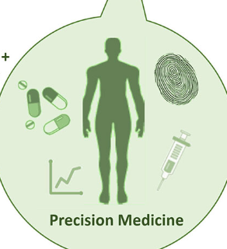





Prediction Methodology Commonly Used in Papers
Download data ➢➢
After reviewing various metrics,
select the best performing
algorithm.
.
.
Import the necessary libraries
and the diabetic dataset.
Conduct a comparison
Evaluation of the outcomes
of each classifier's
experimental performance.
Pre-process the data to
eliminate any missing
information.
.
.
Using the test set, test the
Classifier model for the stated machine learning algorithm.
Divide the dataset
between 80% Training and
20% Test sets using a percentage
split.
Using the training set,
create a classifier model using
the stated machine learning
technique.
Choose a machine learning method,
such as K-Nearest Neighbor,
Support Vector Machin
.
.

Slide 11
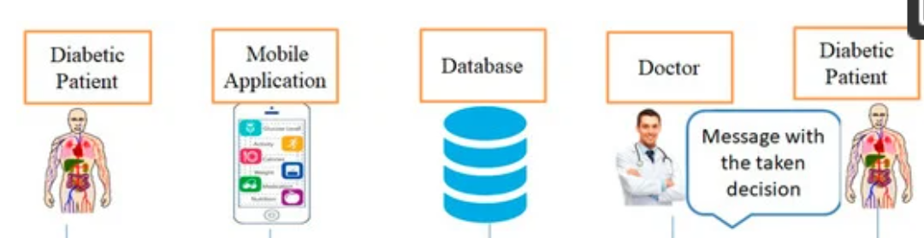
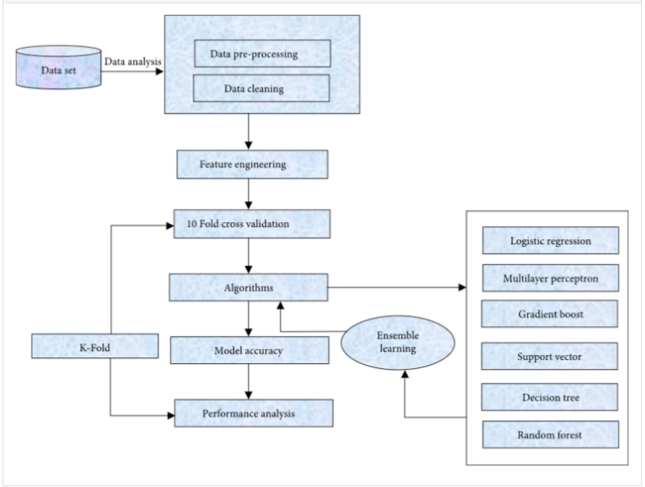
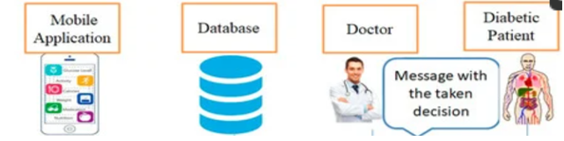
Methodology
.

Slide 12
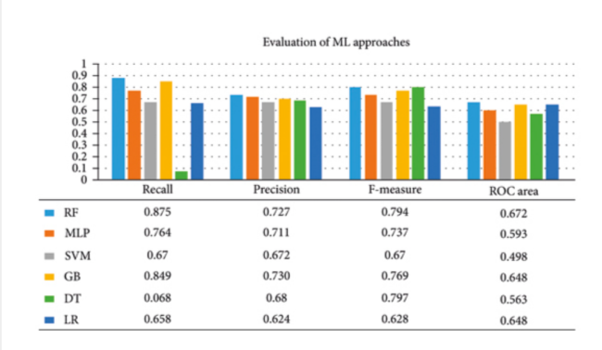
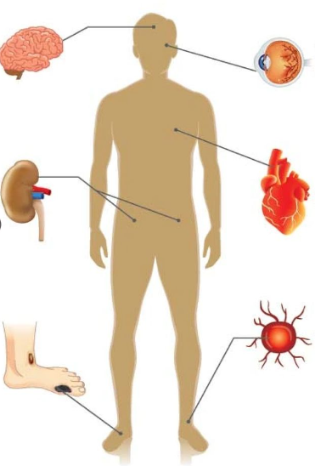
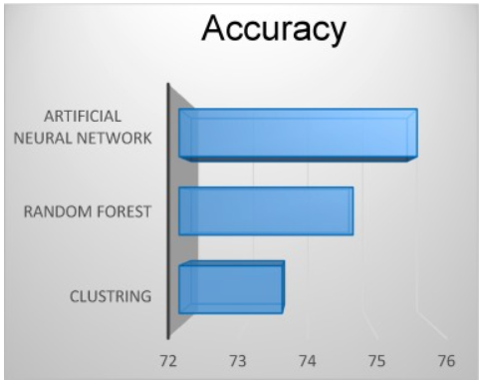
Results
In all publications, they chose certain machine learning algorithms after following the methods described earlier,
and then reached a final result.
.They used a high-accuracy method, and the model was developed as a result.

Slide 13
What I plan to work on is diabetes prediction.
One of the most pressing real-world medical issues is the early identification of diabetes. In this sem project our attempts will be made to build a system that will result in diabetes prediction. Some machine learning classification techniques are examined and assessed on various measures as part of this project activity. Diabetes Database is used for experiments. We choose the algorithm based on the experimental results, which determine the suitability of the created system. The developed system, together with the machine learning classification techniques employed, can be utilised to predict or diagnose various illnesses. The technique may be expanded and refined to include other machine learning algorithms in the automation of diabetes analysis.

Slide 14
References
https://www.hindawi.com/journals/cin/2022/2789760/
https://www.researchgate.net/publication/347091823_Diabetes_Prediction_Using_Machine_Learning
https://www.sciencedirect.com/science/article/pii/S2352914819300176
https://www.ijert.org/diabetes-prediction-using-machine-learning-techniques
https://journalofbigdata.springeropen.com/articles/10.1186/s40537-019-0175-6

Slide 15
20MIA1162
GUNA SHANKAR S
Human Stress Detection
.

Slide 16

The main contribution of the paper is the identification of stress using deep learning and machine learning.
Many studies are being conducted to identify tension or depressed individuals learing about the data and inferencing more deeper.
OBJECTIVE
.

Slide 17
INTRODUCTION
Stress is a problem in our daily lives. There are numerous tension-producing factors in our daily lives. A person may experience stress in some way because of human settings including the workplace, home, or society.
Analysis of stress in people at various stages of life is our goal. sometimes-unnoticed impact of exam stress or recruitment stress on the student. We'll conduct a study on how these influences affect students' minds, and we'll examine the relationship between stress and time spent online.
Palmer states that "Stress is described as a complicated psychological and behavioral condition when the person's needs and the manner in which they are satisfied are out of balance.
Numerous Research are being done to identify people who are anxious or depressed. Table displays some prior research on the stress detection system that was relevant to it. Some researchers used publicly available datasets, while others collected their own datasets for this research.

Slide 18
Algorithms and Efficiency:
Title | Dataset | Result
Stress Detection with Machine Learning and Deep Learning using Multimodal Physiological Data | Public dataset WESAD dataset | Achieved accuracy around 84.32% using ML Algorithms like adaboost,RF..etc
Stress Detection through Speech Analysis using Machine Learning | Public Dataset Ryerson Audio-Visual Database of Emotional Speech and Song (RAVDESS) dataset | CNN- Achieved accuracy 94.26%-
Machine Learning and IoT for prediction and detection of stress | Private Dataset Collected own dataset and classified using Python | LR-66% SVM-68%
Classification of Physiological Signals for Emotions Recognition using IOT | Private Dataset-SAID Dataset Collected own dataset using ECG and GSR SAID Dataset | ANN- Achieved Mean accuracy 75.8%
Abbreviations: RF – Random Forest Generator SVM – Support Vector Machine LR – Linear Regression AdaBoost – Adaptive Boosting ANN – Artificial Neural Network
CNN – Convolutional Neural Network

Slide 19
Progress:
we have many training dataset, public test dataset (which can be used as validation dataset in Kaggle)
Applying Convolutional neural networks (CNN) for facial expression recognition.
Experimenting dropout with batch-normalization.
Experimenting different dropout rates.
For evaluating the prediction performance And Metrics

Slide 20
Background Study
Archana P.et.al[1] used neural community standards, to educate and take a look at the information the usage of Artificial neural community has been mentioned which offers an quick concept approximately utilization of Neural internet standards in subject of Networking security. The houses together with feed ahead lower back propagation community form, gradient descent momentum education purpose, sigmoid switch function, supervised mastering version used to educate the version for predicting fraudulent attack
Yekta Said Can et al[2] provided an analysis of recent studies on stress detection in daily life using wearable technology and smartphones. They classified the literature according to their physiological modality and application settings, such as offices, campuses, cars, and unconstrained situations for daily life, and they briefly discussed and indexed the prospective methodologies employed, research obstacles, and stress management techniques.
Russell Li [3] For binary and 3-class classification, the deep convolutional neural network attained accuracy rates of 99.80% and 99.55%, respectively. For binary and 3-class classification, the deep multilayer perceptron neural network attained accuracy rates of 99.65% and 98.38%, respectively. The networks performed significantly better for both binary stress detection and 3-class emotion categorization than earlier techniques that analyzed physiological signals With the intention of enhancing life quality, we showed how deep neural networks may be used to create reliable, continuous, and noninvasive techniques for stress detection and emotion classification, With the intention of enhancing life quality, showed how deep neural networks may be used to create reliable, continuous, and noninvasive techniques for stress detection and emotion classification.

Slide 21
STEPS
The research approach that was used to do the analysis for this study. The main contribution of the paper is the identification of stress using deep learning and machine learning. The suggested research on stress detection using machine learning and deep learning is shown in the flow diagram below. Five steps can be used to summaries this.
.
1. Data collection
2. Data pre-processing
3. feature extraction
5.performance evolution
4. stress detection classifier
.
.
.

Slide 22
Planned to Work On:
More preventive treatment options are being made possible because to the application of health data analytics, particularly predictive analytics. Despite having access to a wealth of data, the healthcare business is unable to anticipate the future using any practical knowledge.
Collecting the data of snoring_rate,respiration_rate, body_temperature, limb_movement, blood_oxygen,eye_movement, sleeping_hours,heart_rate, stress_level.
Applying different machine learning predicting algorithms and exploring the data , find the stress level of people.

Slide 23
Conclusion
The above literature works presented various methods for detecting the human stress. The existing methods were compared with our paper. In our paper, we used the human parameters and machine learning algorithms for detecting whether the stress is present or not in humans.

Slide 24
References
[1] Archana P., Divyabharathi,P., Camry Joshya, Y., Sudha.V (2021). Artificial Neural Network Model for Predicting Fraudulent Attacks, Journal of Physics: Conference Series, 1979(1), 012016
[2] Y. S. Can, B. Arnrich, and C. Ersoy (2019). Stress detection in daily life scenarios using smart phones and wearable sensors:
[3] Stress detection using deep neural networks Russell Li & Zhandong Liu BMC Medical Informatics and Decision Making
[4] Stress detection using natural language processing and machine learning over social interactions Tanya Nijhawan, Girija Attigeri & T.Ananthakrishna Journal of Big Data volume 9, Article number: 33 (2022) Cite this article
[5] Stress detection using deep neural networks Russell Li1 and Zhandong Liu2,3*

Slide 25
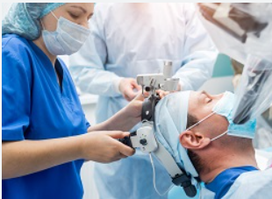
20MIA1117
PILLARAM MANOJ
Brain Stroke Prediction
.

Slide 26
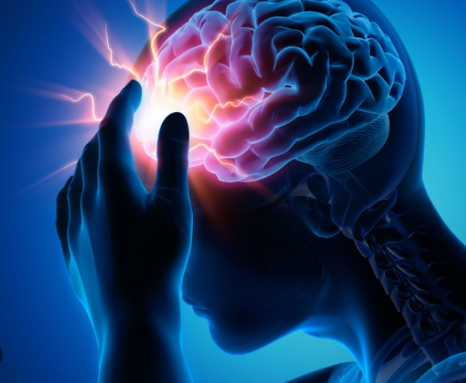
OBJECTIVE
I choosed this topic because,Medicine is one of the most benefited fields and data-driven decisions are becoming increasingly trusted due to their efficiency and accuracy, where medical staff decisions are critical for patients. Brain Stroke is the second leading cause of death worldwide and it is possible to create a model to predict its outcome based on past data and known occurrences. Many of the
risk indicators for stroke can be controlled, making stroke prediction
very promising in terms of reducing the likelihood of suffering from
it by taking the necessary actions and treating people early enough.
.

Slide 27
A brain stroke is a blood clot or bleed in the brain that can result in permanent damage to mobility, cognition, vision or communication. Brain Stroke is a medical emergency that can result in long-term neurological damage, complications and in some cases, it leads to the death.A brain stroke is also known as a cerebrovascular accident or CVA, it occurs when part of the brain loses blood supply and the part of the body controlled by the blood-deprived brain cells stops working. This blood supply loss can be ischemic (lack of blood flow) or haemorrhagic (bleeding into brain tissue).
According to the World Health Organization (WHO), stroke is the second leading cause of death worldwide, accounting for approximately 11% of all deaths. Our ML model uses dataset to predict whether a patient is likely to have a stroke based on input parameters such as gender, age and various diseases. Unlike most datasets, our dataset focuses on attributes that are significant risk factors for a Brain Stroke.
INTRODUCTION

Slide 28
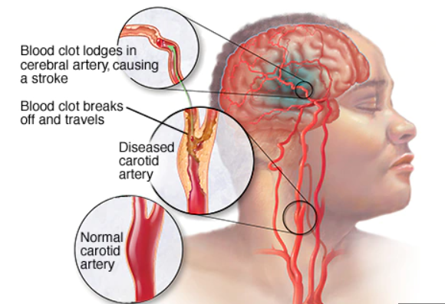
Introduction
Machine Learning (ML) predicts outcomes accurately and quickly and it has become a powerful tool in health settings, providing personalised clinical care for Brain stroke patients.
Although the use of ML and Deep Learning in health care is increasing, some research areas are not receiving enough attention for scientific investigation, despite the fact that there is a genuine need for research. As a result, the goal of this work is to determine and predict the risk of brain stroke using ML algorithms such as logistic regression, SVM, KNN, Decision Trees, and Random Forest.
In five studies for Brain stroke problems, Support Vector Machine (SVM) models were found to be optimal. Furthermore, the majority of studies are in brain stroke diagnosis, while the number of studies in stroke treatment is low, indicating a research gap that needs to be filled. Similarly, CT images are a commonly used dataset in stroke research. Finally, SVM and Random Forests are effective techniques in each category. The current study highlights the contribution of various ML approaches to brain stroke.
Traditional risk factors for brain stroke- it can occur in anyone, regardless of race, gender, or age, but the chances of having a brain stroke increase if an individual has certain risk factors that can cause a barin stroke. Understanding personal risk and how to manage it is the best way to protect oneself and others.

Slide 29
Background study:
The main goal of the research conducted by Manisha Sirsat, Eduardo Ferme, and Joana Camara was to classify state-of-the-arts on ML techniques for brain stroke into four categories based on their functionalities or similarity, and then review studies in each category systematically. The study goes on to discuss the results and accuracies obtained by employing various Machine Learning models.
Geethanjali and their colleagues : According to her paper, Brain stroke attack can be accurately predicted. For Brain stroke prediction, they used three classifiers: logistic regression, decision tree classifier, and support vector classifier. 5110 records were used to create the classification model. And they delivered the result with 95.49% accuracy.
Veena Potdar and others: They described various methods of brain stroke prediction in their paper and concluded that each technique for barin stroke prediction has advantages and disadvantages. To determine which technique to use, statistical analysis and initialization must be performed. However, they suggested that the random forest technique is one of the most precise techniques for analysing and produces promising results.
Ankitha and their colleagues :In their paper, they used a machine learning or AI intelligence algorithm to predict the type of brain stroke a patient is experiencing via an application that incorporates admin, user, and interaction with a specific doctor. Finally, it informs the user about the type of brain stroke he is experiencing.

Slide 30
Background study
.
In their study, Harish Kamal, Victor Lopez, and Sunil A. Sheth discuss how Machine Learning (ML) through pattern recognition algorithms is now becoming an essential aid in the diagnosis, treatment and prediction of complications and patient outcomes in a variety of neurological diseases.
They choose this topic because, A brain stroke is a blood clot or bleed in the brain that can result in permanent damage to mobility, cognition, vision or communication. Brain Stroke is a medical emergency that can result in long-term neurological damage, complications and in some cases, it leads to the death.
They used Algorithm like Decision tree, Navie bayes and Artificial Neural Network for predicting brain stroke.
As a result, their project assists in predicting stroke risk using a prediction model and providing personalised warnings and lifestyle correction messages via a webapplication. By doing so, it encourages medical users to increase their motivation for health management and to change their health behaviours.

Slide 31
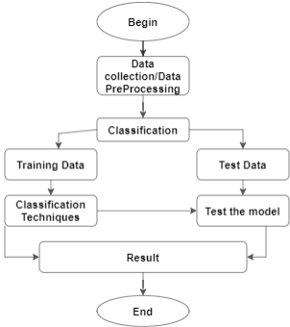
Methodology

Slide 32
Common prediction Methodology used in all papers:
4) ML Model Training:
a) Logistic Regression
b) Decision Tree
c) KNN (K-neighbor)
d) SVM (Support Vector Machine)
e) Random Forest
7) Enter the new information for which a brain stroke must be predicted.
1) Remove any missing values from the training and testing data.
2) Using the Label Encoder to convert objects to integers.
3) Separating data into training and testing sets.
5) Determine the accuracy score for each model.
6) Model choice with the highest accuracy score
Outcome: -Predicted data with respect to the chosen model.
.

Slide 33

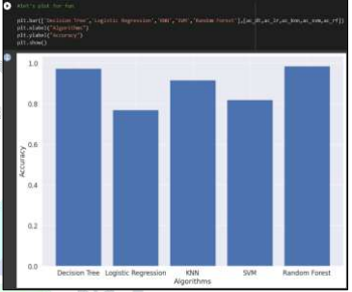
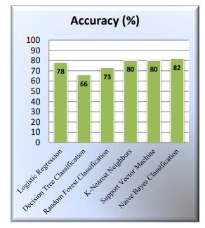
Result
In all research papers, they choose particular machine learning algorithms as we seen in the above methodology and then reached to a final result. They have used a high-accuracy method to find which model has highest accuracy compare to other algorithms and also they find that which model is optimal and that model they developed as a result.

Slide 34
What I am planning to work on this brain stroke prediction
Brain Stroke is the fourth leading cause of death worldwide and it continues to be a significant health burden for both individuals and national healthcare systems. Hypertension, diabetes, and dysregulation of glucose metabolism, atrial fibrillation and lifestyle factors are all potentially modifiable risk factors for brain stroke.
By studying the research papers, As a result the goal of our project is to apply machine learning principles to large existing data sets in order to effectively predict brain strokes based on potentially modifiable risk factors. In this semester project our attempts will be made to build a system that will result in brain stroke prediction.
Some machine learning techniques are examined and assessed on various measures as part of this project activity. The technique may be expanded and refined to include other machine learning algorithms in the automation of brain stroke analysis.

Slide 35
References
https://www.sciencedirect.com/science/article/pii/S2772442522000090
https://www.iieta.org/journals/ria/paper/10.18280/ria.340609
https://www.ahajournals.org/doi/full/10.1161/STROKEAHA.118.024293
https://www.irejournals.com/formatedpaper/1703646.pdf
https://ijcrt.org/papers/IJCRT22A6052.pdf

Slide 36
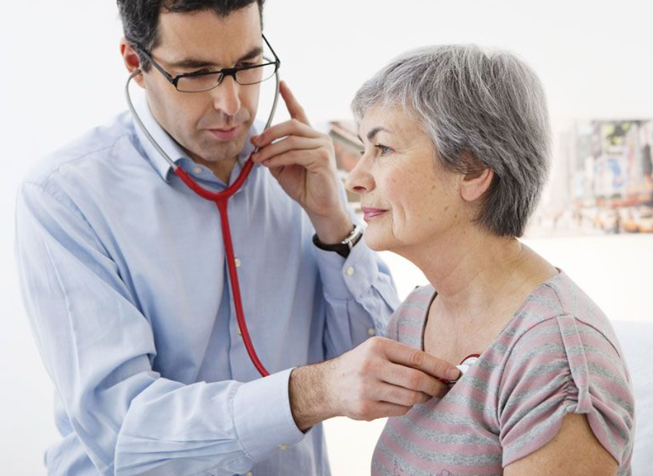
20MIA1039
SRIGANTH.R
Heart Disease Prediction
.

Slide 37
Heart Disease Prediction
OBJECTIVE
Heart disease, often known as cardiovascular disease, is one of the leading causes of mortality worldwide. Because it accounts for 35% of all deaths worldwide.So, if we can predict someone's chance of developing heart disease, that would be beneficial.
According to WHO: Cardiovascular diseases (CVDs) are the leading cause of mortality worldwide, claiming the lives of an estimated 17.9 million people each year.
CVDs are a collection of heart and blood vessel illnesses that include coronary heart disease, cerebrovascular disease, rheumatic heart disease, and others. Heart attacks and strokes account for more than four out of every five CVD fatalities, and one-third of these deaths occur in adults under the age of 70.
Heart disease, often known as cardiovascular disease, encompasses a variety of disorders that affect the heart and has been the leading cause of mortality globally in recent decades. In the United States alone, about one person dies from heart disease every minute.
Cases of heart illness are developing at an alarming rate, and it is critical and important to predict any such ailments in advance.
It identifies various risk factors in heart disease and a necessity of the time to obtain accurate, dependable, and sensible ways to early detection in order to accomplish timely disease management.

Slide 38
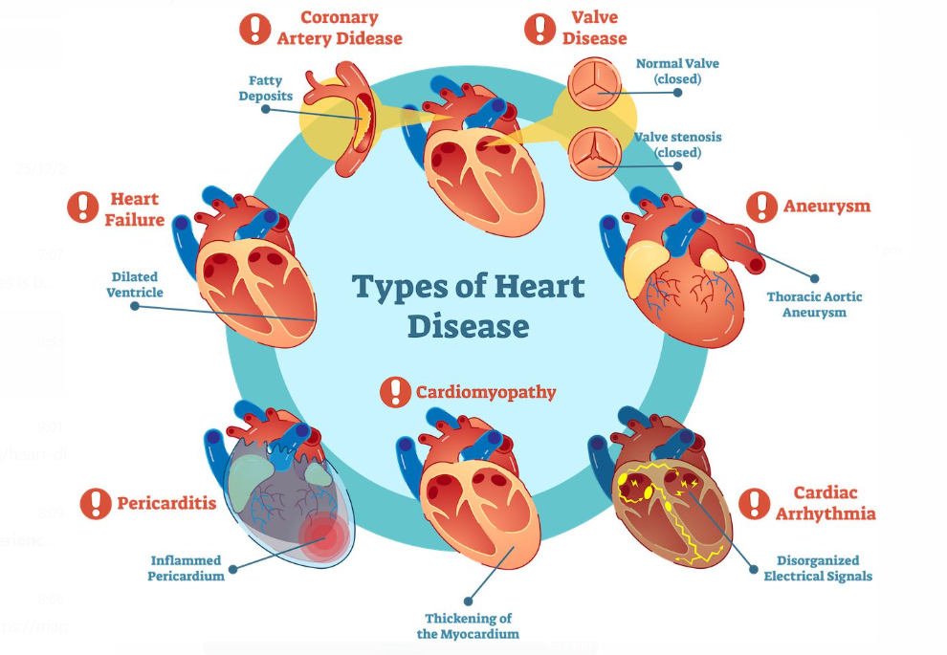
Introduction
Among the many life-threatening disorders, heart disease has received a lot of attention in medical research. The diagnosis of heart illness is a difficult undertaking that can enable automated prediction about the patient's heart health so that future therapy can be made successful. Heart disease is often diagnosed based on the patient's indications, symptoms, and physical examination. Smoking, high cholesterol levels, a family history of heart disease, obesity, high blood pressure, and a lack of physical activity are all risk factors for heart disease.
Heart disease is one of the leading causes of illness and mortality in the world's population. One of the most significant topics in clinical data analysis is the prediction of cardiovascular disease. The healthcare business generates a massive quantity of data. Data mining converts a significant amount of raw healthcare data into information that may be used to make more educated decisions and forecasts.
Diabetes, high blood pressure, excessive cholesterol, an irregular pulse rate, and a variety of other risk factors make it harder to detect heart disease. Because of these limits, scientists have resorted to current technologies for illness prediction such as Data Mining and Machine Learning.
Machine learning (ML) has proven to be successful in aiding in decision-making and prediction from the huge amount of data generated by the healthcare business.

Slide 39
Background study
Avinash Golande and colleagues investigate several ML algorithms that might be utilised for heart disease classification. A study was conducted to examine the accuracy of Decision Tree, KNN, and K-Means algorithms that may be utilised for classification. The study concludes that the Decision Tree obtained the best accuracy, and that it may be made more efficient by combining multiple methodologies and parameter adjustment.
T.Nagamani created a system that used data mining techniques in conjunction with the MapReduce algorithm. According to the article, the accuracy gained for the 45 instances of testing set was larger than the accuracy obtained using traditional fuzzy artificial neural network. The combination of dynamic schema and linear scaling increased the accuracy of the method utilised in this case.
Fahd Saleh Alotaibi created a machine learning model that compares five alternative methods. When compared to Matlab and Weka, the Rapid Miner tool produced greater accuracy. The accuracy of Decision Tree, Logistic Regression, Random Forest, Naive Bayes, and SVM classification algorithms was compared in the study. The decision tree algorithm was the most accurate.
Anjan Nikhil Repaka and colleagues suggested a system in that employs NB (Nave Bayesian) approaches for dataset categorization and the AES (Advanced Encryption Standard) algorithm for safe data transport for illness prediction.

Slide 40
Background study
Theresa Princy R conducted a survey that included several classification algorithms used to predict cardiac disease. The classification approaches employed were Naive Bayes, KNN (KNearest Neighbour), Decision tree, and Neural network, and the accuracy of the classifiers was evaluated for a variety of attribute counts.
Nagaraj M Lutimath used Naive Bayes classification and SVM to predict cardiac disease (Support Vector Machine). The performance measures employed in the analysis were Mean Absolute Error, Sum of Squared Error, and Root Mean Squared Error, and it was determined that SVM outperformed Naive Bayes in terms of accuracy.
S. Vijiyaraniet published An Efficient Classification Tree Technique for Heart Disease Prediction in 2013. The classification tree strategies in data mining are examined in this work. Decision Stump, Random Forest, and LMT Tree are the classification tree methods employed and assessed in this work. The study's goal was to examine the results of different classification algorithms' performance on a heart disease dataset.
Vembandasamy used the Naive Bayes method to diagnose heart problems. In Naive Bayes, Bayes' theorem is applied. As a result, Nave Bayes has a strong principle of independence. The data used came from one of Chennai's major diabetic research organisations. The data collection includes 500 patients. WEKA is utilised as a tool, and 70% of the Percentage Split is used for categorization. Naive Bayes has an accuracy of 86.419%.

Slide 41
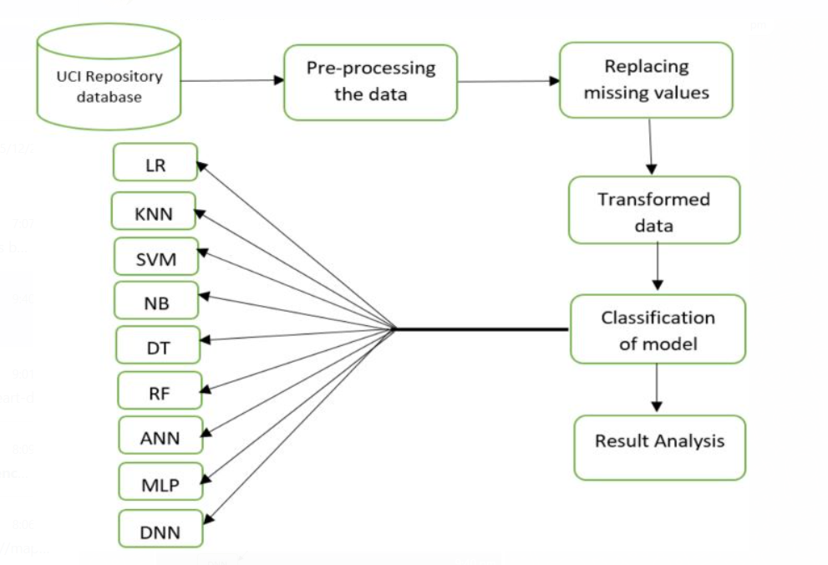
Steps
.

Slide 42
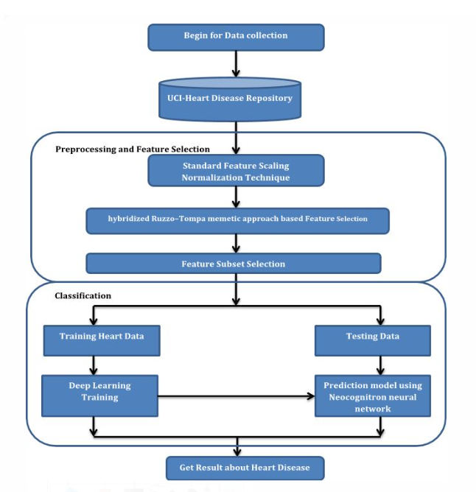
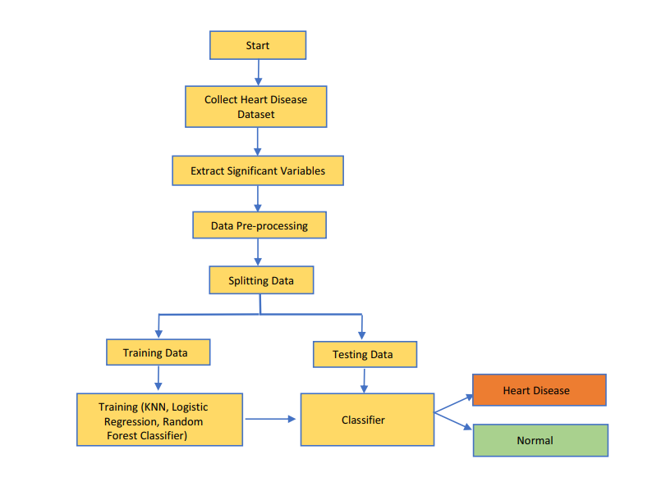
Methodology
According to the data and information we gathered, we discovered that the following actions must be completed in order to obtain more accurate forecasts. The following are the tasks that we will complete.

Slide 43
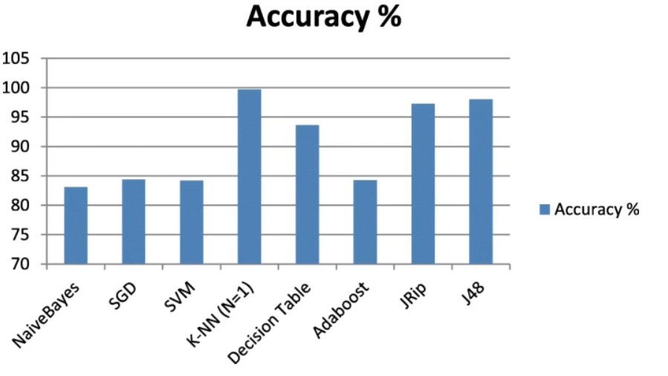

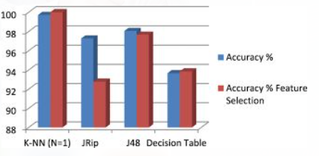
Conclusion
Based on the above-mentioned research, it
is possible to infer that machine learning
algorithms have a large potential for
predicting cardiovascular disorders or
heart-related diseases. We employed
several data mining and machine learning
techniques to determine which model has the
best accuracy in comparison to other algorithms,
as well as which model is optimum and which model we built as a consequence.

Slide 44
What I want to do about heart disease prediction
The purpose of our project is to use machine learning concepts to big current data sets in order to successfully forecast heart disease based on possibly modifiable risk variables, as a consequence of examining numerous research publications on heart disease prediction. During this semester's project, we will aim to create a method that will anticipate cardiac disease.
As part of this project activity, certain machine learning algorithms are explored and evaluated using various metrics. In the automation of heart disease prediction, the approach might be developed and modified to include additional machine learning techniques.

Slide 45
References
https://link.springer.com/article/10.1007/s42979-020-00365-y
https://citeseerx.ist.psu.edu/document?repid=rep1&type=pdf&doi=587432f342adab0b3cd00b392d474e8100d8df45
https://ieeexplore.ieee.org/abstract/document/8740989/
https://www.academia.edu/download/79534142/5a18f6653b56138cd5196d20e2f39de189e3.pdf
https://ieeexplore.ieee.org/abstract/document/6164626/

Slide 46
20MIA1106
MADHUKIRAN P
Insurance claim prediction
.

Slide 47
Introduction
Insurance is a mechanism that allows interested individuals to make regular financial contributions (premiums) to a central domain 'pool', which is used to compensate individuals who have suffered losses as a result of their contributions. A problem that has existed worldwide for many years is the high cost of health care services, due to the increasing demand for these services and the apparent slowdown in supply (McConnell, 1999).
National Health Insurance (NHI), also known in other countries as statutory health insurance (GKV), is a constitutional scheme in most countries that guarantees citizens against medical expenses. is intended for Programs may be administered by the private sector, the public sector, or both, depending on funding sources. Each country has its own sources of funding, depending on the type of program being run.
However, the information that can be used to make predictions comes from two sources.
The first is a list of customer attributes (eg customer demographics and insurance coverage information) and the second is the customer's hospital bill history.
The latter can be viewed as a time series of unevenly spaced events. Furthermore, each hospitalization itself can be represented as a set of hospital services that the patient received during that particular hospitalization .
Although it is straightforward to present the first type of information directly as features for classification algorithms, time-series data mining and point processes such as admission above are still a developing area of ​​research. Extracting relevant information in a useful way is very difficult. The relative timing of recorded hospital visits used in predictions seems likely to carry subtle but valuable information that, if properly collected, could lead to more accurate predictions

Slide 48
Background study
Dong et al. (2019) presented a computational framework for reservoir computing using fixed-weight recurrent neural networks (RNNs). The authors proposed several physical implementations to improve power efficiency and speed using the scattering model.
Dumas et al. (2019) reviewed various neural network architectures for intra-frame prediction. The authors demonstrate that fully connected neural networks tend to provide better performance with small block sizes, whereas convolutional neural networks perform better with large blocks with complex textures. provided.
Liu et al. (2019) proposed a deep learning-based neural network prediction model for image compression. The authors first clarified predictions for multi-class classification problems and a framework for transforming multi-class classification into binary classification problems that can be solved with only one binary classifier. We then built a deep learning-based binary classifier to predict whether one image is lossy with another. The authors also proposed a sliding window search strategy. This helped predict the outcome of the lossless predictor. Experimental results show that perceptually lossless predictors have higher average accuracy. The research displayed superior results for the proposed neural model as compared to the conventional models
A random rough subspace-based neural network ensemble method proposed by Xu, Wang, Zhang, and Yang (2011) for insurance fraud detection. In this method, a coarse set of reductions is first used to produce a set of reductions that can keep the data information consistent.
.

Slide 49
Background study
Dong et al. (2019) proposed a novel neural network model for health-related predictive models of blood glucose variability in populations and individuals. The authors incorporated pre-training and fine-tuned processes to overcome the problem of insufficient individual patient data and to take full advantage of population and individual differences and variability. Compared with other machine learning and neural network approaches, numerical results show that the proposed approach achieves significant improvement in prediction accuracy.
Don et al. (2019) proposed a new neural prediction approach based on recurrent neural networks (RNN). The author integrated the clustering pre-processing into his conventional RNN. Numerical results show that the proposed approach uses multiple clusters for both type I and type II datasets and improves in terms of prediction accuracy achieved compared to support vector regression (SVR) and other RNN methods.
Epilepsy is a neurological disorder associated with abnormal electrical activity in the brain that causes seizures. Seizure occurrence is unpredictable. The length of time between attacks, as well as symptoms, vary from patient to patient. Nashat et al. (2019) designed and implemented a monitoring system for epilepsy patients. The system must continuously check several vital signs and analyze the readings to determine if the patient is about to have a seizure. The system triggers an alarm each time a seizure is predicted. In addition, you must send notice to the responsible health authority and your preferred contact person. Implementation of surveillance systems will increase opportunities for people suffering from epilepsy to work and lead normal lives.
Liou, Tang, and Chen (2008) reviewed the use of artificial neural networks in hospitals and health care providers. Artificial neural networks can be used for detection for exaggerated and fraudulent health insurance claims initiated by government insurance systems. Their study applied data mining techniques to uncover fraudulent or abusive reports from health care providers using outpatient diabetes service bills.

Slide 50
Plan of Action
We aim to solve the problem statement by creating a plan of action, Here are some of the necessary steps:
1.Data Exploration
2.Exploratory Data Analysis (EDA)
3.Data Pre-processing
&
Data Manipulation
5.Project Outcomes & Conclusion
4.Feature Selection/Extraction
&
Predictive Modelling

Slide 51
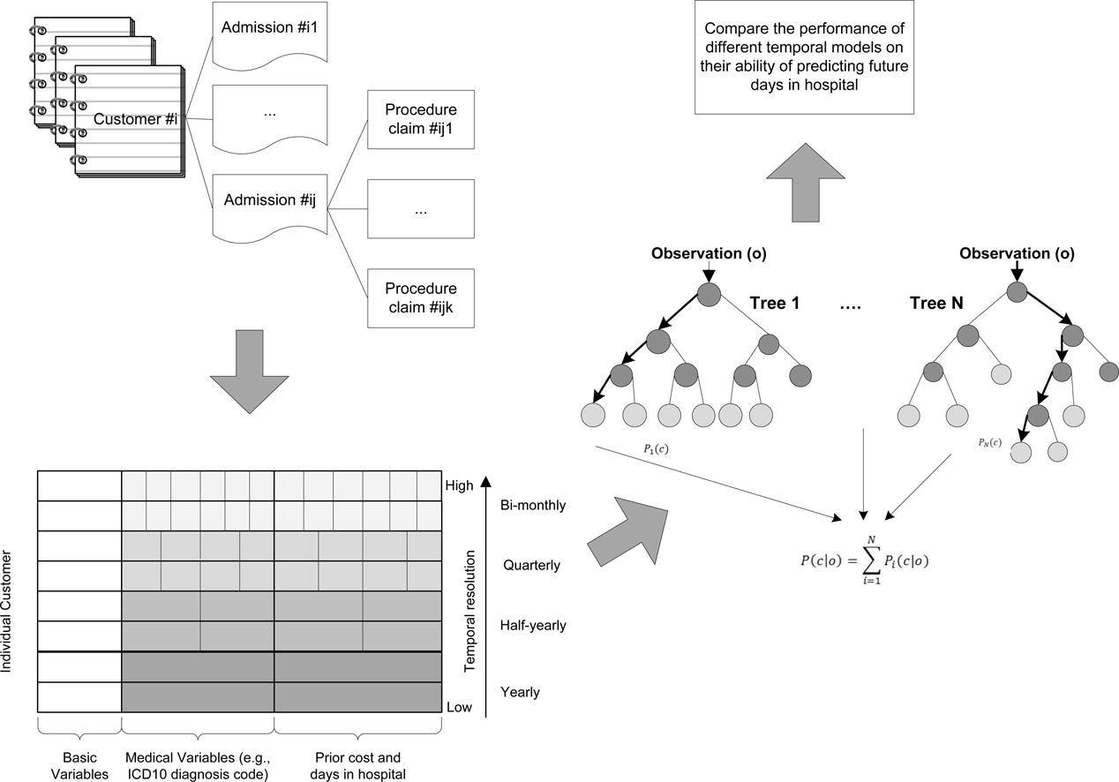
Methodology
According to the data and information we gathered, we discovered that the following actions must be completed in order to obtain more accurate forecasts. The following are the tasks that we will complete

Slide 52
The purpose of our project is to use machine learning concepts study and analyze the trend of health insurance claims and its future prediction claims.
As part of this project activity, certain machine learning algorithms are explored and evaluated using various metrics.
Applying different machine learning predicting algorithms and exploring the data , finding the health insurance claims and its future prediction claims.
Future Plan of work
.

Slide 53
Conclusion
Future hospital days can be predicted using a temporal data mining technique. On time intervals (bins), equally spaced time series features were built with the goal of capturing sensitive temporal information and enhancing prediction results. To investigate how altering the temporal resolution might affect the prediction power, four models with bins of various lengths—namely, year, half-year, quarter, and two months—have been developed.
Note that billing codes may be allocated retroactively; for example, coding mistakes may occur and may be corrected after the fact. Because a diagnosis is necessary for claim reimbursement, doctors frequently record a diagnosis during emergency treatments even in the absence of conclusive test findings. Later, the claim reimbursement might be adjusted and these billing codes changed. Moreover, late claims could be received by insurer after the patient has been discharged from the hospital (e.g., claiming more than a year after discharge).

Slide 54
References
<http://www.aihw.gov.au/australias-health/2012/spending-on-health/>.
<http://www.heritagehealthprize.com/c/hhp/leaderboard/milestone1>.
http://www.sciencedirect.com/science/article/pii/S0004370296000252
http://www.sciencedirect.com/science/article/pii/0004370284900080
<http://www.stat.berkeley.edu/breiman/RandomForests/cc_home.htm>.

Slide 55
THANK YOU！

